Slide 1

Sensor integrated vacuum gripper
Alex Furman under supervision of prof. Rimon

Slide 2
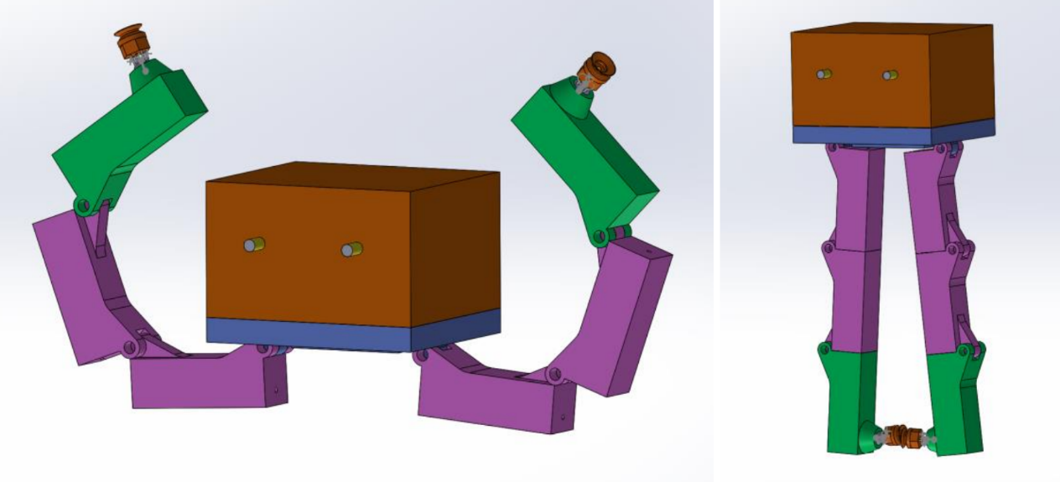
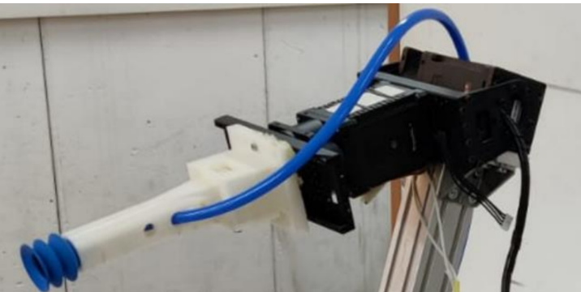
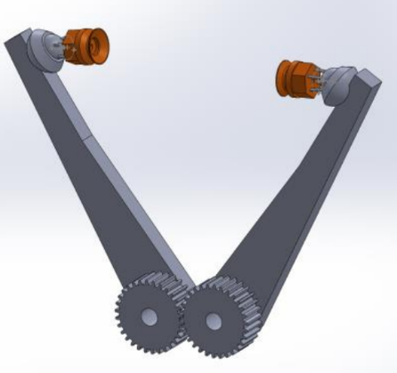
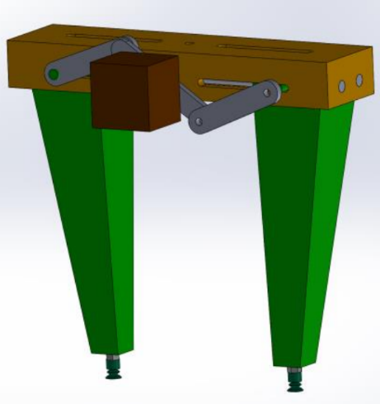
Semester 1: Project description
Initial ideas
Create gripper with vacuum tech
Integrate with ROS
Final Product

Slide 3
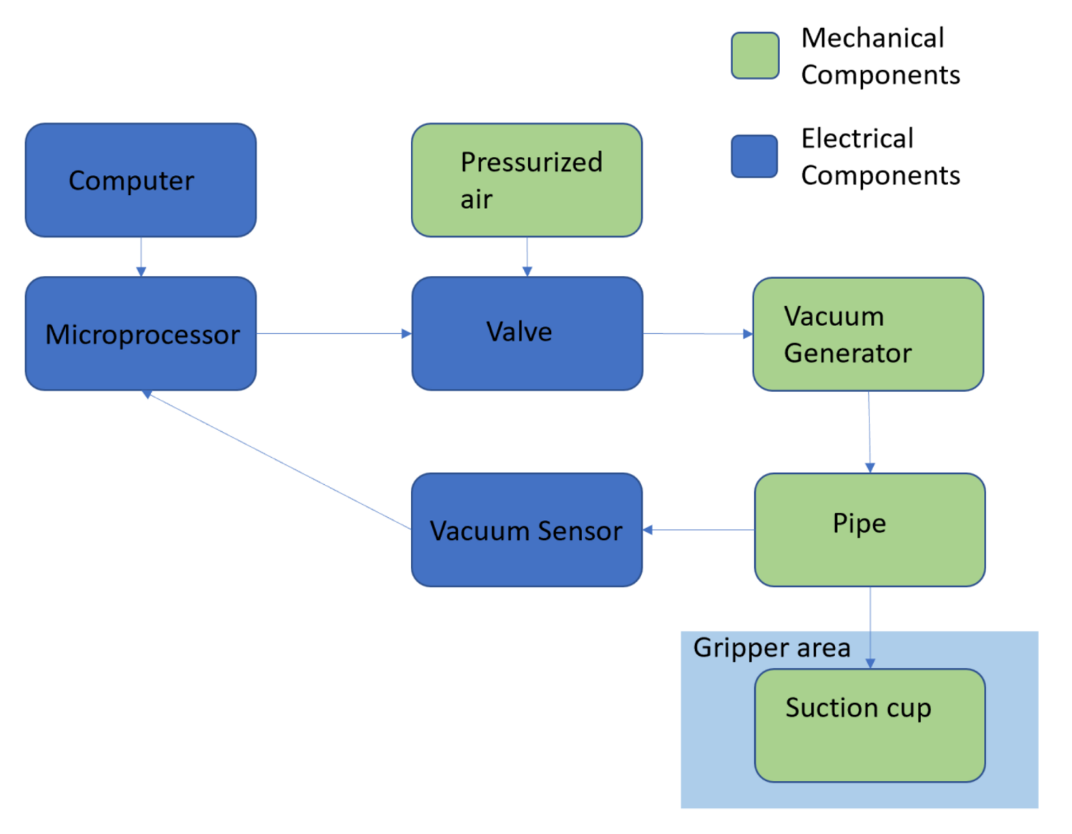
Semester 1: System description

Slide 4
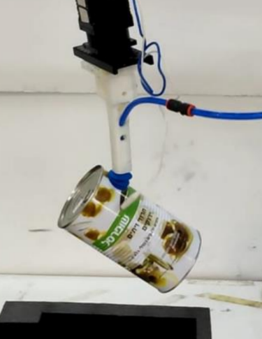
Semester 1: design strengths + weaknesses
Strengths:
Very compact
Strong suction
Weaknesses:
Only handles smooth surfaces well
Requires very accurate placement
Does not handle torques well at suction cup

Slide 5
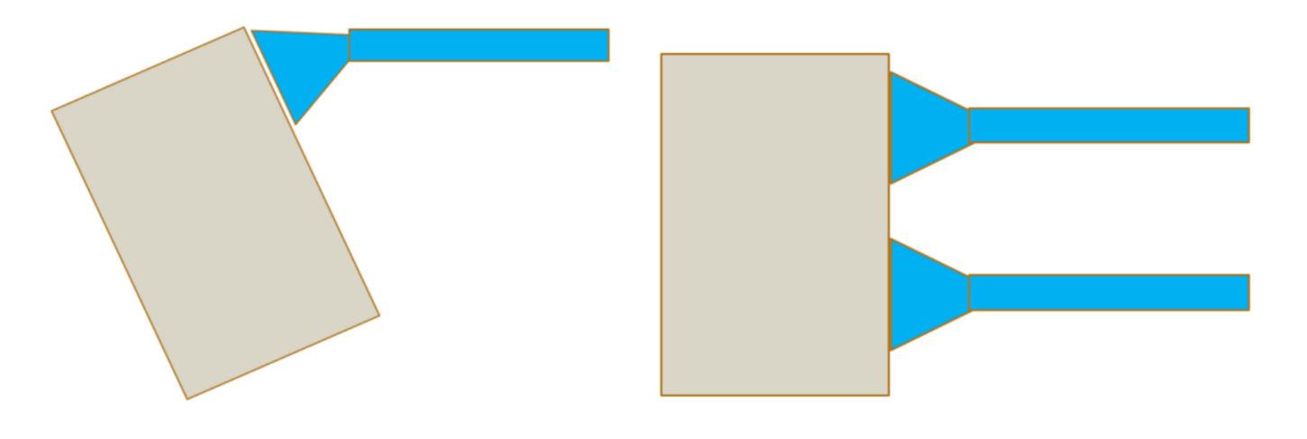
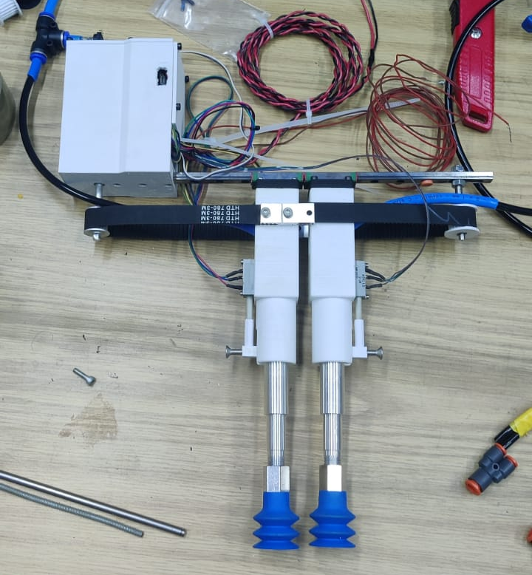
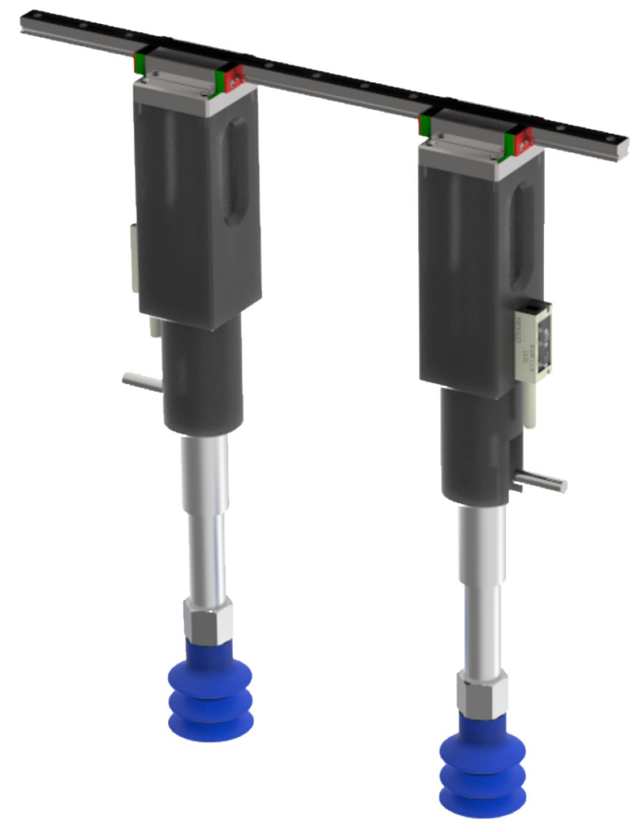
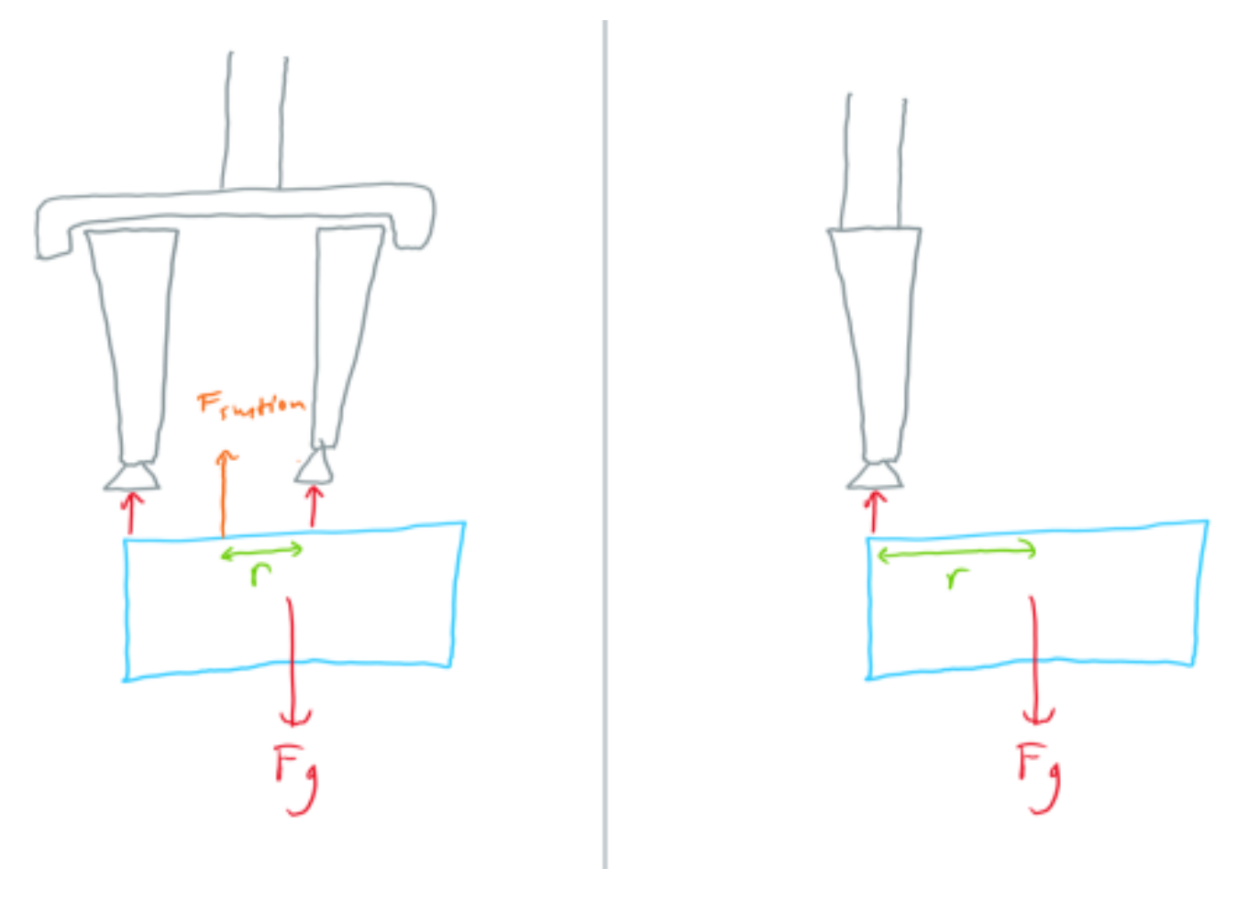
Semester 2: Project description
Minimize design weaknesses
Improve gripper placement given inaccuracies in Computer Vision

Slide 6
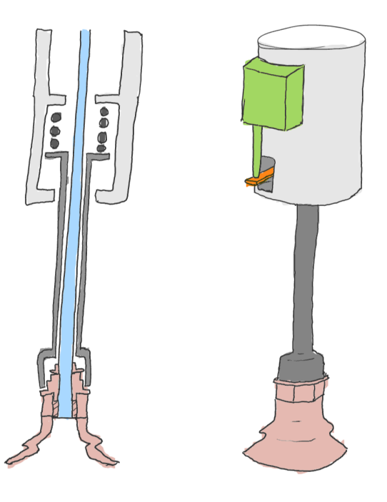
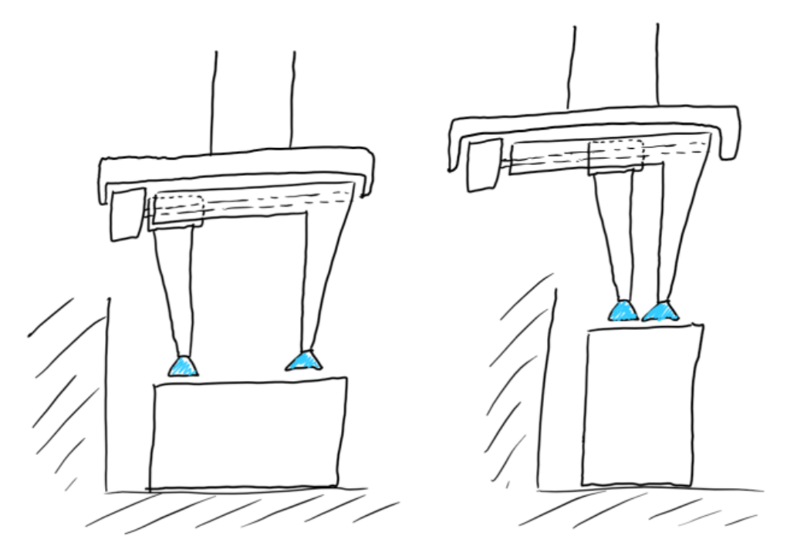
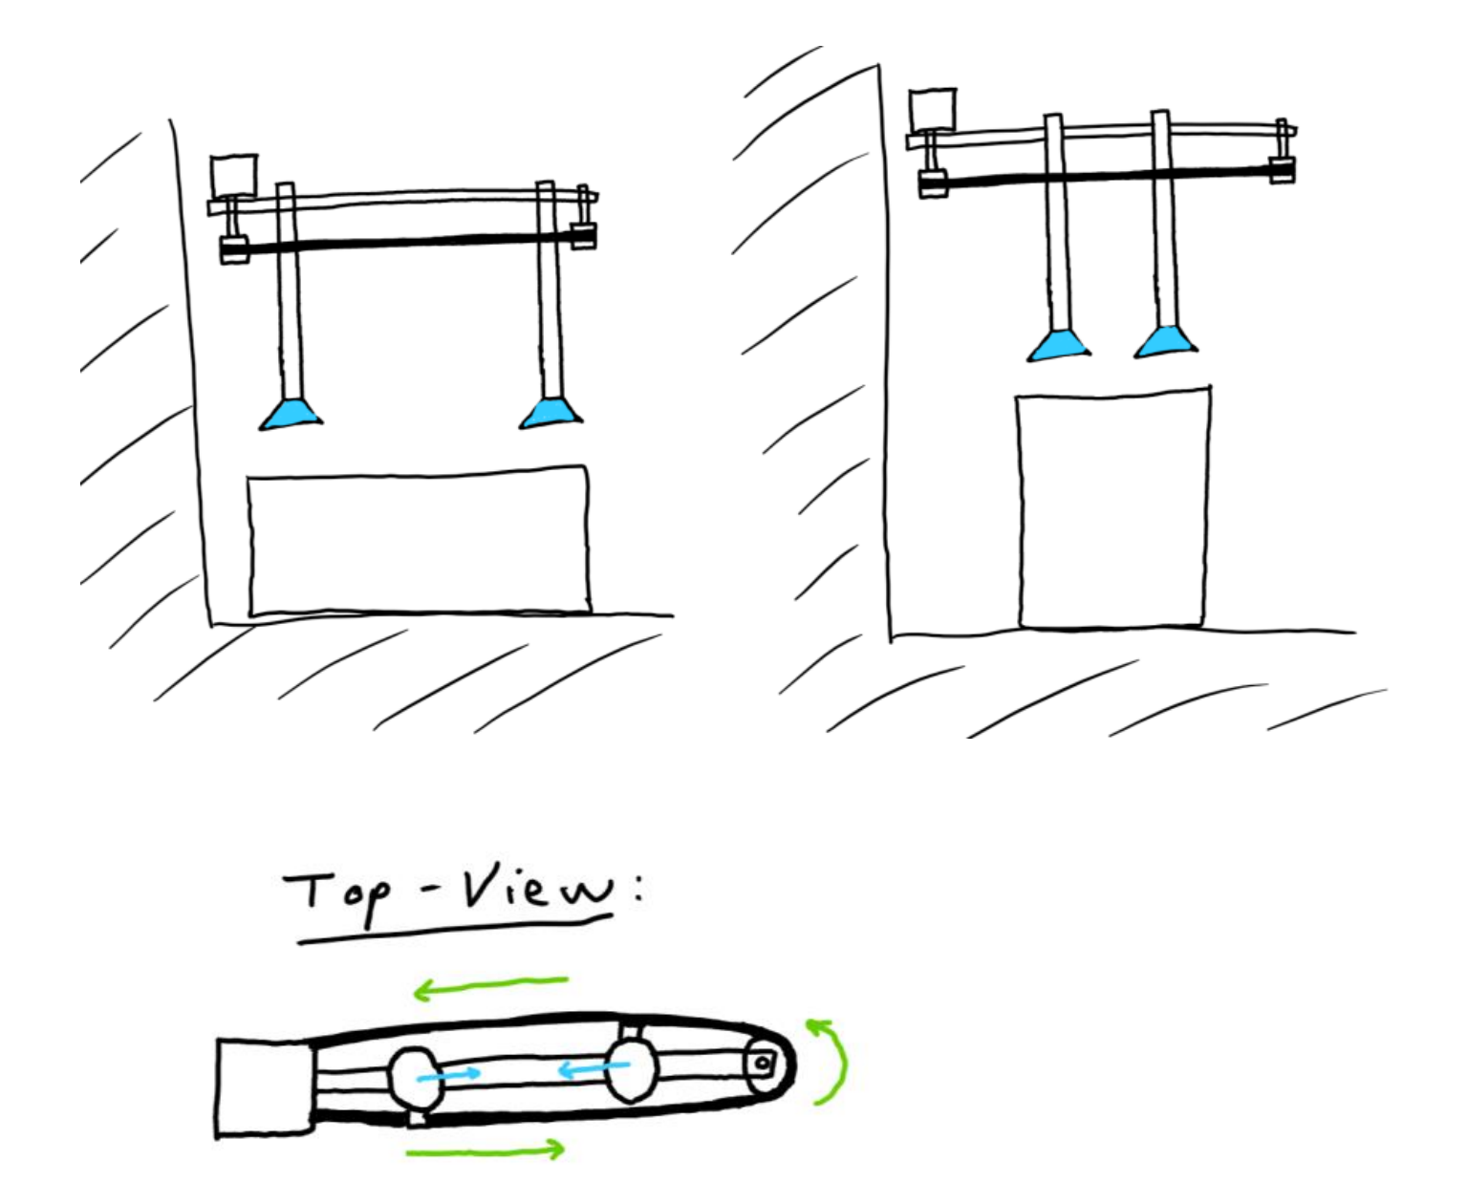
Semester 2: Illustrations
Finger Design
Belt Driven vs Lead-screw Driven

Slide 7
Semester 2: System description
Pressurized air
Motor
Vacuum Generator
Belt + Pulleys
Computer
Valve
Valve
Plunger System
Plunger System
Railing
Microprocessor
Vacuum Sensor
Linear Potentiometer
Linear Potentiometer
Suction Cup
Suction Cup

Slide 8
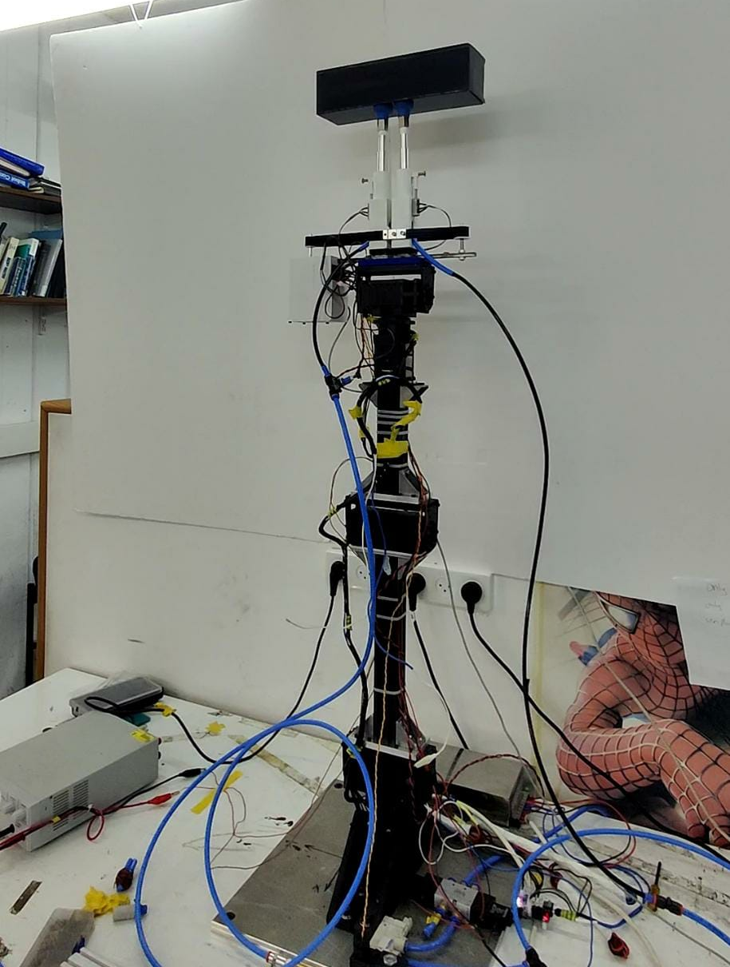
Semester 2: design strengths + weaknesses
Strengths:
Addresses torque issue from previous design
Now possible to create correction algorithms due to the potentiometers
Weaknesses:
Force produced in each finger effectively halved (only one vacuum generator)
Bigger than last design
A lot more mechanical parts + electronics – harder maintenance
Notes:
More testing should be done to determine if extra vacuum generator is necessary
Some components of the design can be improved in later iterations

Slide 9
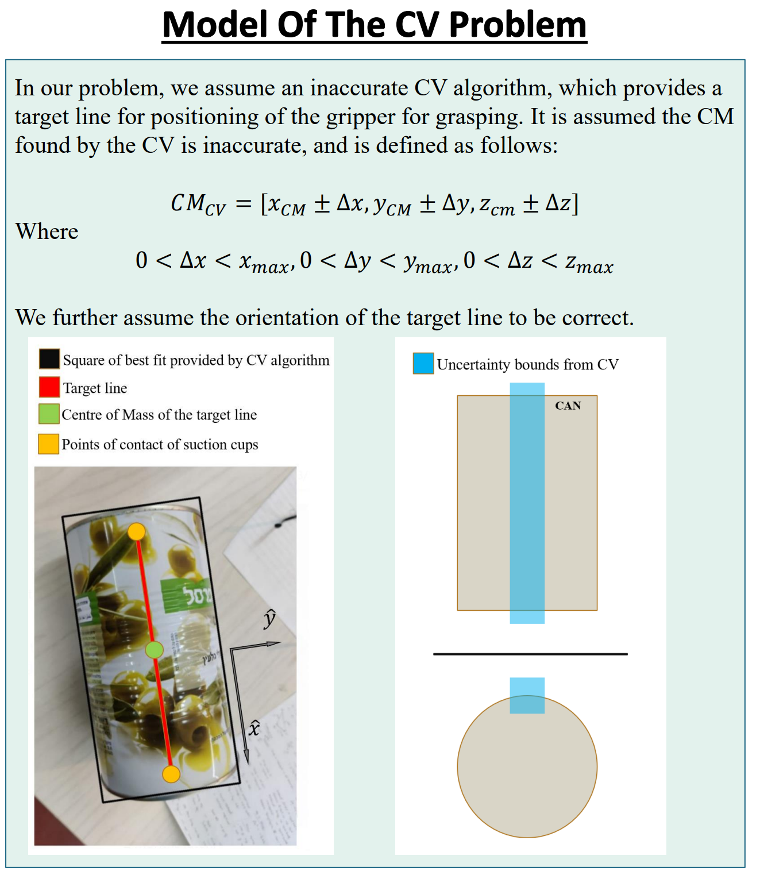
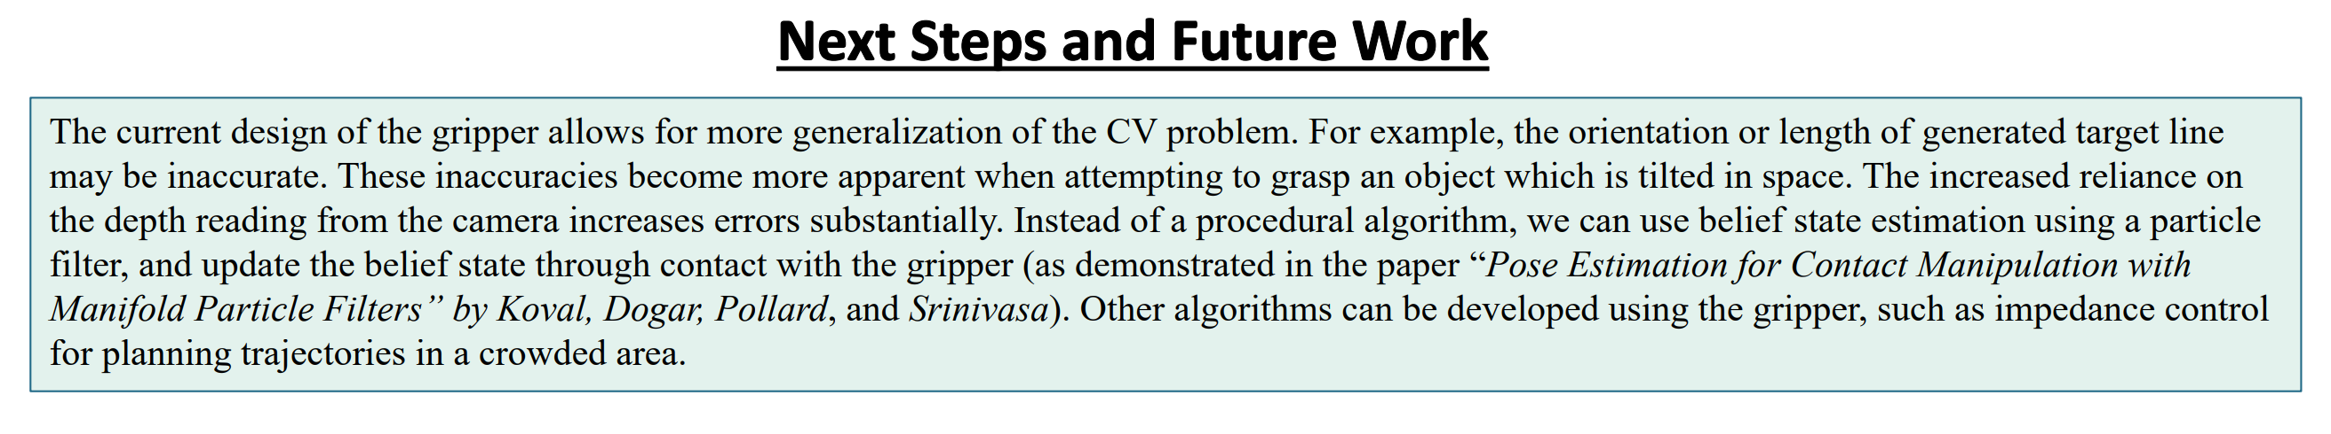
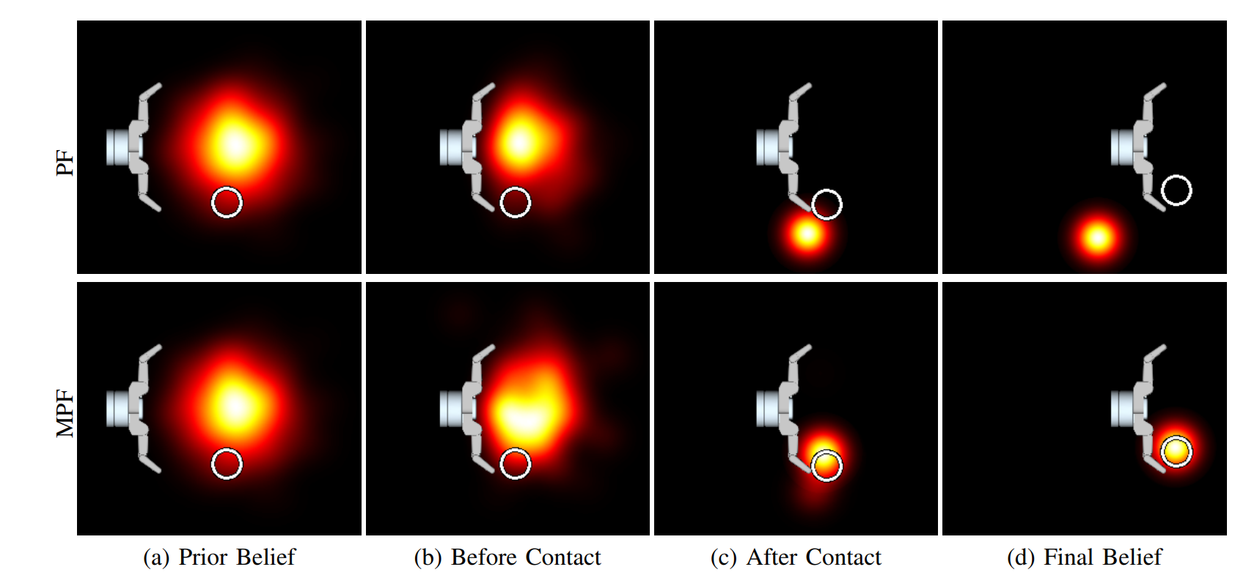
Future work: algorithms

